Slide 1
Understanding cross-country suicide rates: an Interpretable Machine Learning Approach
Dania Ali Abuhijleh
& Arthur Langlois
Northeastern University, Department of Mathematics

Slide 2
Project Description
Our project has two main goals
1- Automatize prediction of suicides rates in a next period (t+1) when inputed relevant data (at t = 0)
2- Understand the leading factors determining suicide rates at the country level
The first half of study will be conducted through the use of both Autoregressive Linear Models and Convolutional Neural Networks, and the second half will make use –and explore the differences- between state-of-the art Machine Learning Interpretability tools such as SHAP values, Permutation Feature Importance, and LIME.
Our dataset will be comprised of monthly suicide rates from the WHO, as well as state-specific, time-varying variables such as internet searches for keywords suggesting suicide ideation (gathered from Google trends), as well as the availability of mental health services, unemployment rates or education (mainly gathered from the World Bank).
We hope our study can provide insights and guidance to policy-makers regarding future suicide rates in their respective countries, as well as informing them –and the general public – of its major determinants.

Slide 3
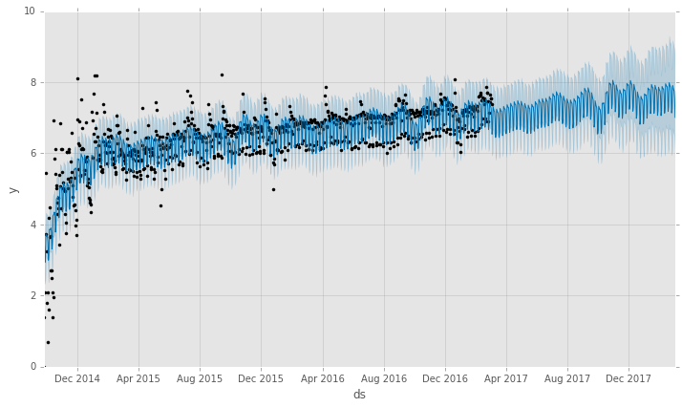
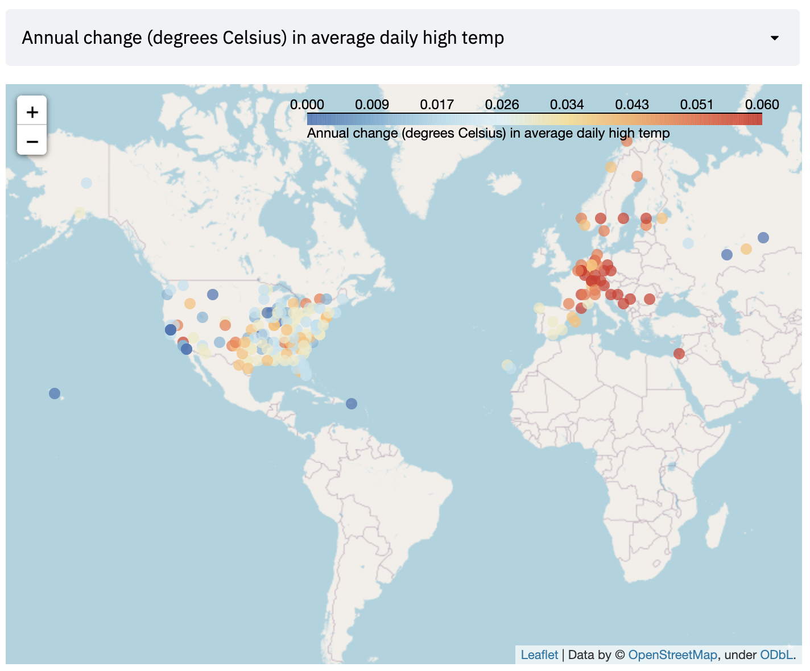
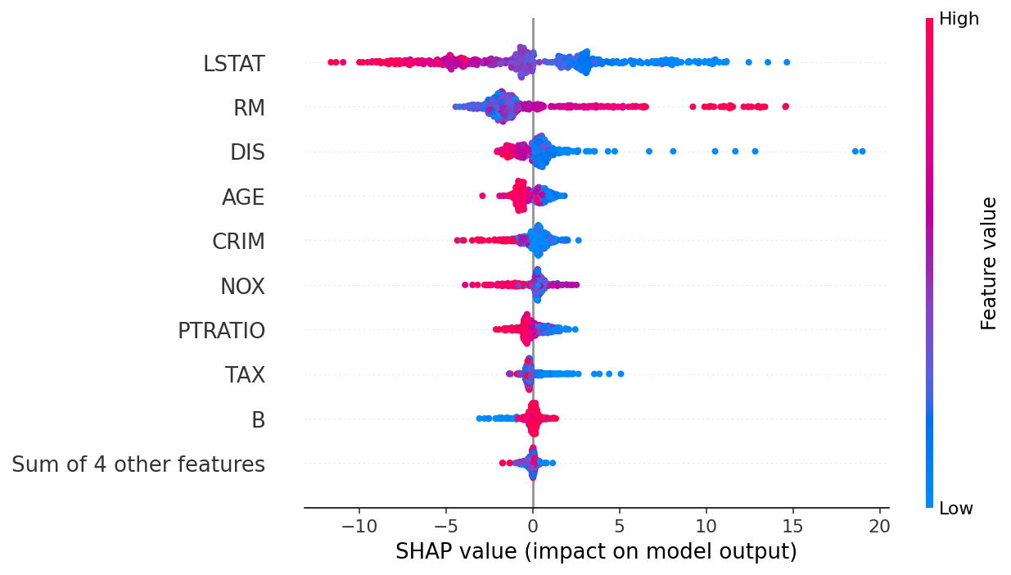
Variables:
- country
- year
- suicide number
- age category
- gdp
- gdp per capita
- share of population with mental health disorders
- literacy
- rural population
- unemployment
- population over 65 yo
- fertility rate
- health expenditure per capita
- depression rates
Methods:
Suicide prediction by category
Customizable Autoregressive Linear Models
What are the drivers of suicides ?
SHAP values
Outputs
- Geographic Dashboard

